Slide 1
Bruce Power - Outage AI Project
January 2021
Notes:
Paul
Welcome to our latest edition of our Technology Webinar Series. I hope you are all safe and where possible working from home. A big shout out and thankyou to all the front-line staff, first responders, and anyone who is helping as our world wide community goes through this Covid struggle. I am excited about todays topic. We have been talking about the new norm for a while now, during the next 30 minutes we want to really dive into how to achieve high performance collaboration while working from home – specifically using Microsoft Teams.

Slide 2
Technical Architecture
NOTES
Redis cache may not be required
Uses Existing API Gateway
Search engine SOLR(on-premise) vs Algolia(cloud)
Staging site needs to be secured with KeyCloak
Static Site Generator invoked on changes (except Alerts/Search)
ETL Tool (if is this needed) – need to research data sets
Admin site can possibly leverage existing platforms like Intranet/SharePoint

Slide 3
Strapi vs Drupal
Feature | Strapi | Drupal
Authoring | Disconnected from front end | Inline Authoring
API | Build in auto-generated/Good API Management tools | Needs Plugin/More complex to setup and manage
Forms | Not available | Forms plugin allow no code forms authoring
Publishing | Basic draft/publish for all content. No workflow | Full editorial Workflow including site preview
Plugins | Small set of stable plugins available | Large library of stable plugins including feature like SEO/Social Media/CDN integration
Community Support | Smaller support community | Large community of online support and developers
Complexity | Easy to install/setup, use and customize | Much more complex setup and has a much larger technical footprint
Common deployment scenario | Smaller static web site primarily managed by technical web admins and focused on API management | Larger more dynamic and complex web sites managed by communications and marketing teams

Slide 4
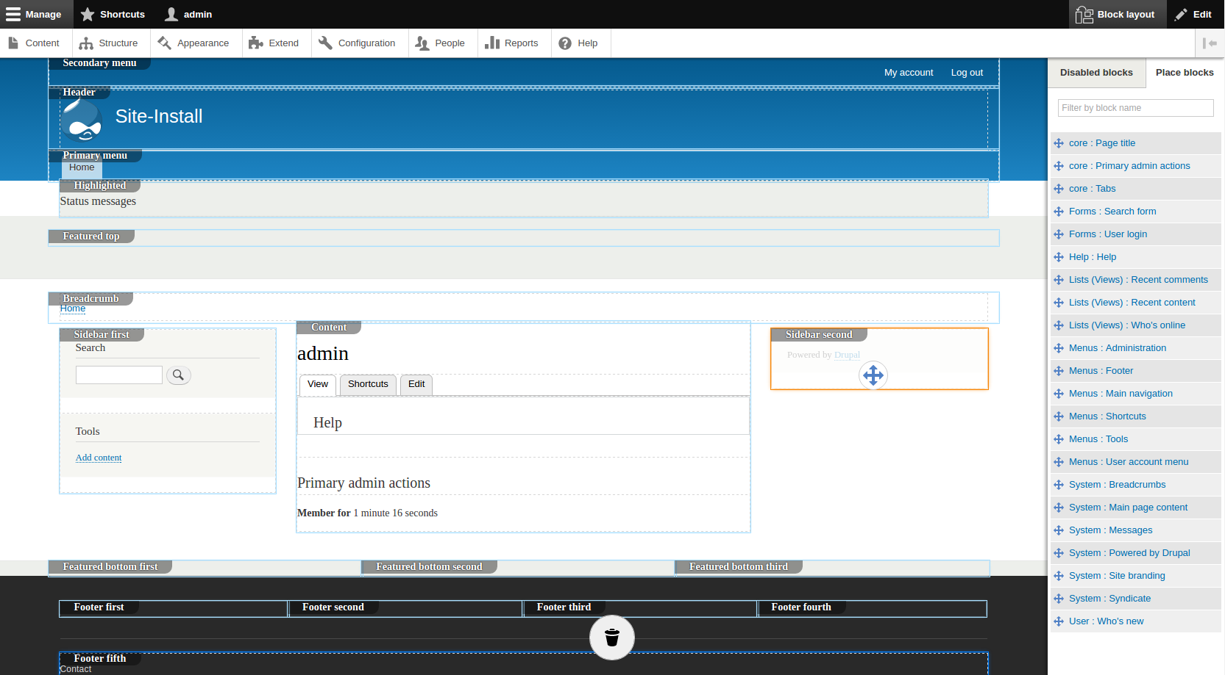
Drupal Authoring Experience

Slide 5
API Architecture

Slide 6
API Gateway – DataBC
Kong API Gateway (https://developer.gov.bc.ca/API-Gateway-(powered-by-Kong-CE))
Registration URL for Kong https://argg.apps.gov.bc.ca/int/
Vanity URL (https://api.bcparks.ca)
API Keys
Rate Throttling
Self Service API Key Generation
OpenAPI Spec
API Catalog registration https://catalogue.data.gov.bc.ca/dataset

Slide 7
API Design Considerations
API Versioning eg https://api.bcparks.ca/v1/parks
Naming convention – camelCase
Basic Strapi Authentication – 2 users : public/admin (SSO requires Strapi GOLD edition)
Custom routing in Strapi
/park/<ORCNumber>/advisories
/park /<ORCNumber>/ fees/
Data BC API standards https://github.com/bcgov/api-guidelines/blob/master/government-of-british-columbia-api-guidelines.md

Slide 8
Site Architecture
NOTES
Load balanced public facing containers
Site build triggered on demand
Gatsby hosted on staging container
Storage mounted as read only to public containers
Gatsby Strapi plugin
Where to store images – CMS vs storage vs CDN

Slide 9
Notes:
paul

